Slide 1
WebR
R compiled for WebAssembly and running in the browser
George Stagg
RStudio

Slide 2
Why run software in a browser?
Lots of potential reasons!
Containerisation
Notebook / Jupyter
Universal binaries
Sandboxing
Reproducible output
Mobile / Tablet development
Let me tell you my own reasons for creating webR…

Slide 3
How can we capture R code and evaluate it on devices outside of our control?

Slide 4
> 2*2
[1] 4

Slide 6


> df$prop[100]
> rnorm(10, 20, 5)
> hist(data)
> x^5

Slide 7
Solution: Evaluate the R code locally inside a web browser!

Slide 8

WebAssembly (2017)
Portable binary code format
Enables high-performance applications on web pages
Near-native execution speed
Supported by most modern browsers

Slide 9

Emscripten (2012)
C/C++ compiler for WebAssembly
Based on LLVM/Clang
Originally designed for ASM.js in web browsers
DOSBox, SQLite, CPython

Slide 10

How building with Emscripten should work

Slide 11
However… R uses FORTRAN code
BLAS (1979)
LAPACK (1992)
Various other subroutines…
Not directly supported by Emscripten

Slide 12
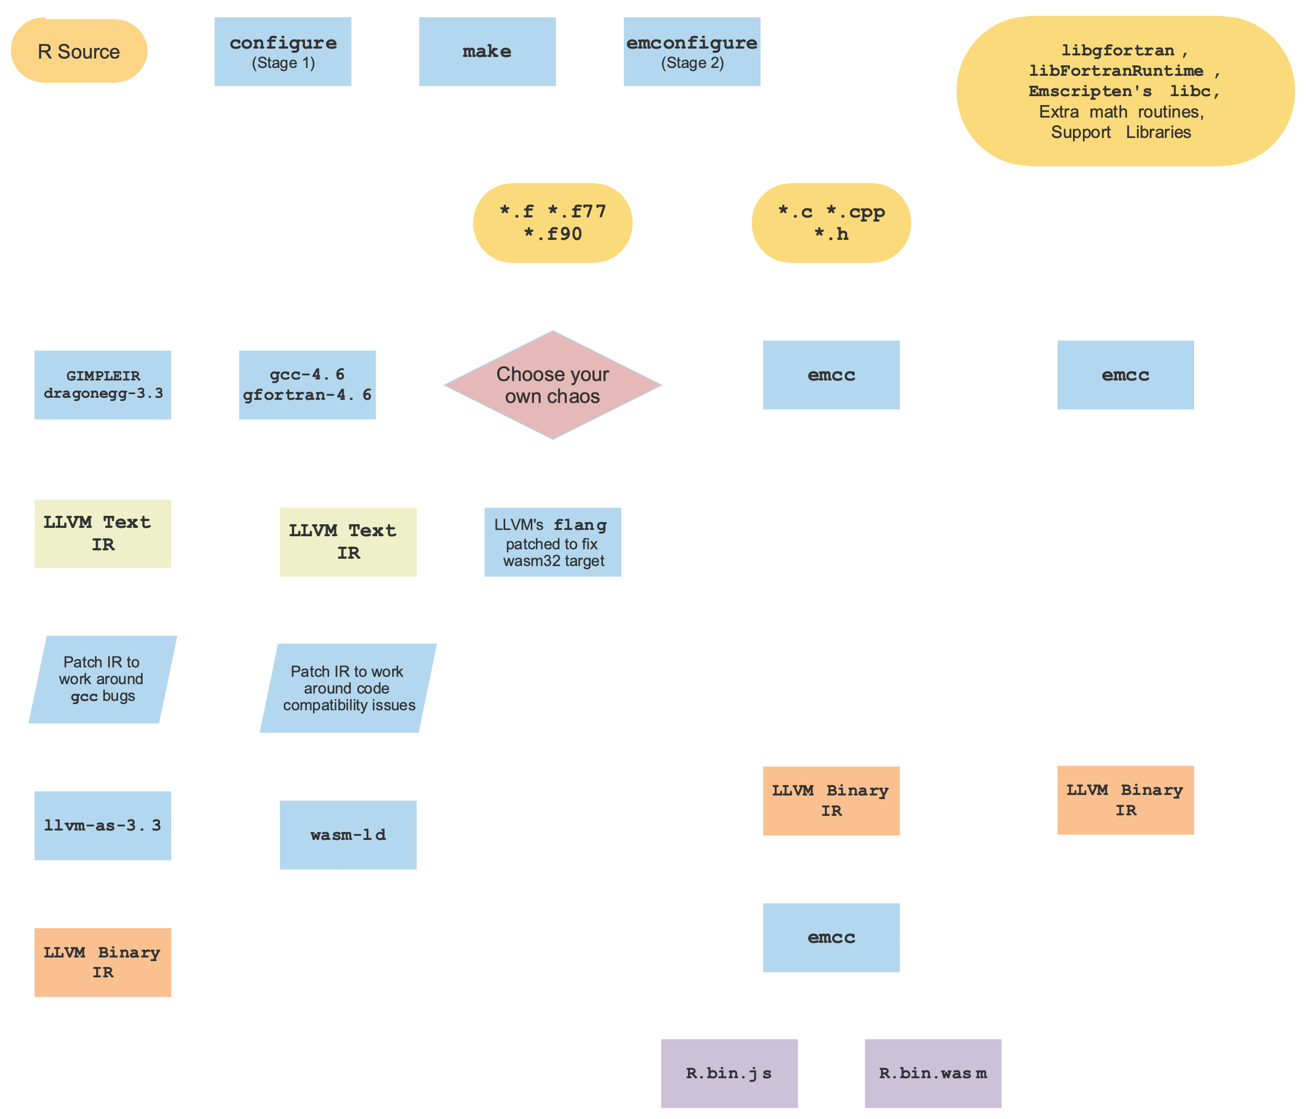
How building R with Emscripten actually works:
I won’t go into detail,
it’s a little messy…
Learn more @
https://chrz.de/2020/04/21/fortran-in-the-browser/

Slide 13
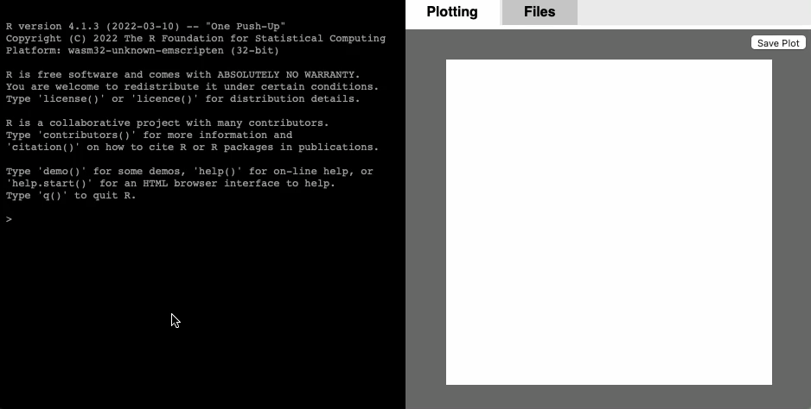
…but it works!
Try it for yourself @ https://webr.gwstagg.co.uk

Slide 14
WebR
R compiled for WebAssembly and running in the browser
Try it for yourself @ https://webr.gwstagg.co.uk
Source code @ https://github.com/georgestagg/webR
George Stagg
RStudio

